Slide 1
Exception class Hierarchy
An Error is a subclass of Throwable that indicates serious problems that a reasonable application should not try to catch. Most such errors are abnormal conditions.
Exception
Error
IOException
SQLException
MalformedURLException
…..
RunTimeException
NullPointerException
NumberFormatException
ClassCastException
ArithmeticException
….
VirtualMachineError
IOError
AnnotationFormatError
…….
Object
Throwable
The Throwable class is the superclass of all errors and exceptions in the Java language.
The class Exception and its subclasses are a form of Throwable that indicates conditions that a reasonable application might want to catch.

Slide 2
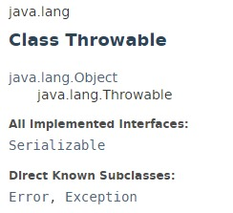
Exception class Hierarchy

Slide 3
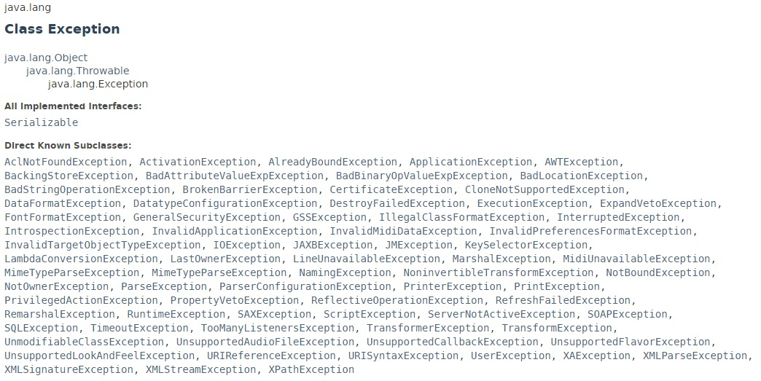
Exception class Hierarchy

Slide 4
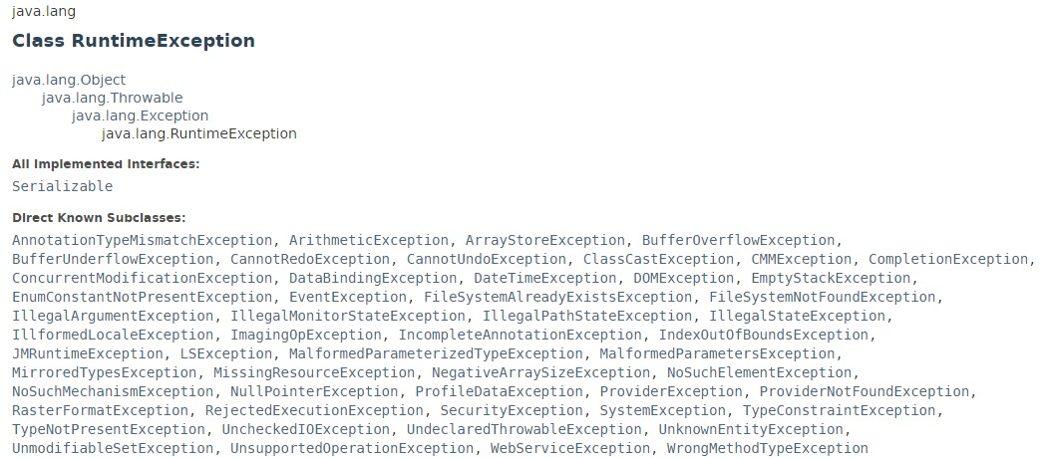
Exception class Hierarchy

Slide 5
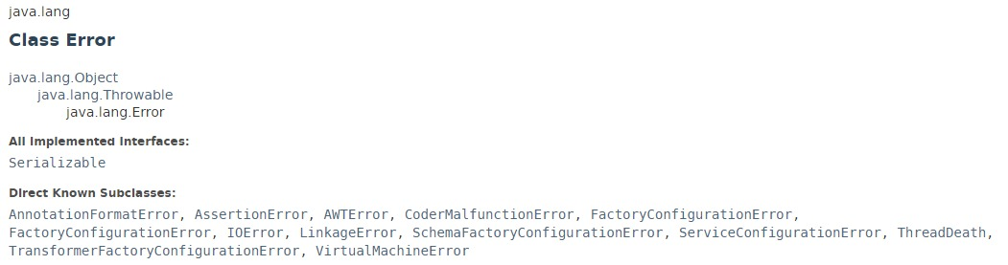
Exception class Hierarchy

Slide 6
Exception class Hierarchy
https://docs.oracle.com/javase/8/docs/api/index.html?java/lang/Throwable.html

